Slide 1
A Deep CASA Approach to Talker-independent Speaker Separation
DeLiang Wang
(joint with Yuzhou Liu)
Perception & Neurodynamics Lab
Ohio State University

Slide 2
Outline
Introduction
The cocktail party problem
Computational auditory scene analysis (CASA)
Speech separation as DNN based mask estimation
Talker-dependent speaker separation
Human listener test
Talker-independent speaker separation
Deep CASA approach

Slide 3
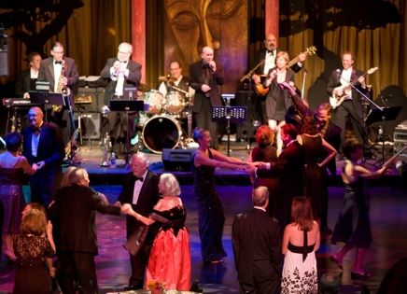
Real-world audition
What?
Speech
message
speaker
age, gender, linguistic origin, mood, …
Music
Car passing by
Where?
Left, right, up, down
How close?
Channel characteristics
Environment characteristics
Room reverberation
Ambient noise
Notes:
3

Slide 4

Sources of intrusion and distortion
additive noise from
other sound sources
channel distortion
reverberation from
surface reflections
Notes:
4

Slide 5
Cocktail party problem
Term coined by Cherry
“One of our most important faculties is our ability to listen to, and follow, one speaker in the presence of others. This is such a common experience that we may take it for granted; we may call it ‘the cocktail party problem.’ No machine has been constructed to do just that.” (Cherry, 1957)
Speech separation problem
Speech enhancement: speech-nonspeech separation
Speaker separation: multi-talker separation

Slide 6
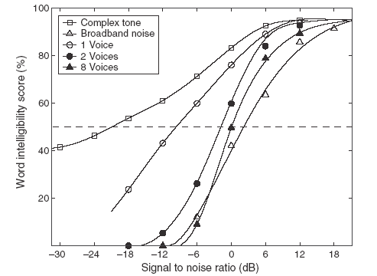
Human performance in different interferences
23 dB difference in Speech Reception
Threshold!
Source: Wang & Brown (2006)
Notes:
6
don’t comment at this point on the effect of competing speakers

Slide 7
Auditory scene analysis (ASA)
Listeners are capable of parsing an acoustic scene (a sound mixture) to form a mental representation of each sound source – stream – in the perceptual process of auditory scene analysis (Bregman, 1990)
From acoustic events to perceptual streams
Two conceptual processes of ASA:
Segmentation. Decompose the acoustic mixture into sensory elements (segments)
Grouping. Combine segments into streams, so that segments in the same stream originate from the same source

Slide 8

Simultaneous organization
Simultaneous organization groups sound components that overlap in time. ASA cues for simultaneous organization:
Proximity in frequency (spectral proximity)
Common periodicity
Common spatial location
Common onset (and to a lesser degree, common offset)
Common temporal modulation
Amplitude modulation
Frequency modulation

Slide 9
Sequential organization
Sequential organization groups sound components across time. ASA cues for sequential organization:
Proximity/continuity in time and frequency
Common spatial location; more generally, spatial continuity
Smooth pitch contour
Rhythmic structure

Slide 10
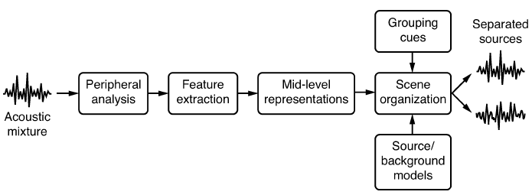
Computational auditory scene analysis
Computational auditory scene analysis (CASA) approaches sound separation based on ASA principles
Feature based approaches
Model based approaches

Slide 11
Ideal binary mask as a separation goal
Motivated by the auditory masking phenomenon and auditory scene analysis, we suggested the ideal binary mask as a main goal of CASA (Hu & Wang, 2001; 2004)
The idea is to retain parts of a mixture where the target sound is stronger than the acoustic background, and discard the rest
The definition of the ideal binary mask (IBM)
θ: A local SNR criterion (LC) in dB, which is typically chosen to be 0 dB
Optimal SNR: Under certain conditions the IBM with θ = 0 dB is the optimal binary mask in terms of SNR gain (Li & Wang, 2009)
Maximal articulation index (AI) in a simplified version (Loizou & Kim, 2011)
It does not actually separate the mixture

Slide 12
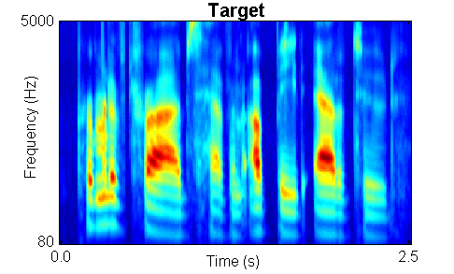
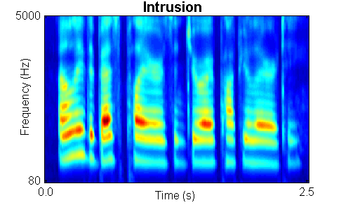

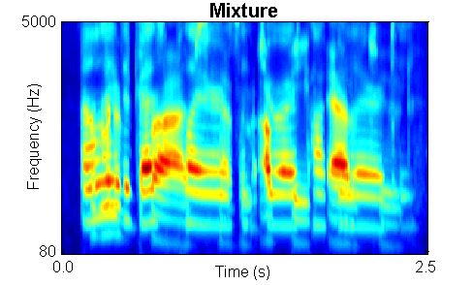
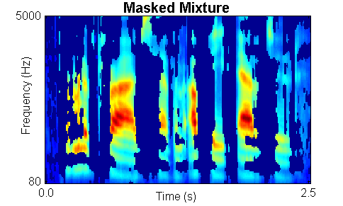
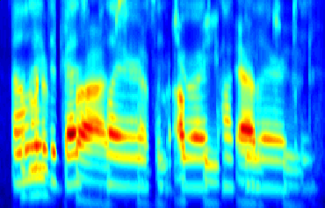
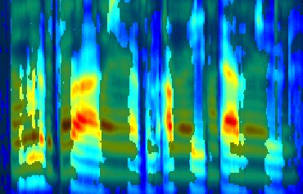
IBM illustration

Slide 13
Subject tests of ideal binary masking
IBM separation leads to dramatic speech intelligibility improvements
Improvement for stationary noise is above 7 dB for normal-hearing (NH) listeners (Brungart et al.’06; Li & Loizou’08; Ahmadi et al.’13; Chen’16), and above 9 dB for hearing-impaired (HI) listeners (Anzalone et al.’06; Wang et al.’09)
Improvement for modulated noise is significantly larger than for stationary noise
With the IBM as the goal, the speech separation problem becomes a binary classification problem
This new formulation opens the problem to a variety of pattern classification methods
Notes:
Brungart and Simpson (2001)’s experiments show coexistence of informational and energetic masking.
They have also isolated informational masking using across-ear effect when listening to two talkers in one ear experience informational masking from third signal in the opposite ear (Brungart and Simpson, 2002)
Arbogast et al. (2002) divide speech signal into 15 log spaced, envelope modulated sinewaves. Assign some to target and some to interference: intelligible speech with no spectral overlaps

Slide 14
Speech separation as DNN based mask estimation
Y. Wang and Wang (2013) first introduced deep neural networks (DNNs) to address the speech separation problem
DNN is used for as a subband classifier and classification aims to estimate the IBM
DNN based classification produced substantial speech intelligibility improvements for HI (and NH) listeners, for the first time (Healy et al.’13)

Slide 15
Outline
Introduction
The cocktail party problem
Computational auditory scene analysis (CASA)
Speech separation as DNN based mask estimation
Talker-dependent speaker separation
Human listener test
Talker-independent speaker separation
Deep CASA approach

Slide 16
Speaker separation
Kinds of speaker separation
Talker-dependent: Test speakers have been used during training
Target-dependent: Target speaker has been used during training, but not interfering speakers
Talker-independent: No test speaker has been used during training
Earlier work shows that DNN based mask estimation remains an effective approach to address talker or target dependent speaker separation (Huang et al.’14; Du et al.’14)
We recently addressed reverberant talker-dependent speaker separation as DNN-based ideal ratio mask (IRM) estimation (Healy et al.’19)
The IRM can be viewed as a soft version of the IBM

Slide 17
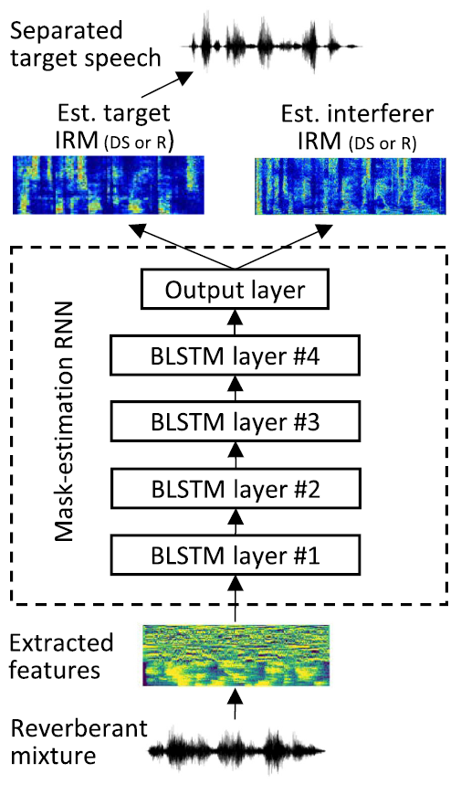
Ratio masking for reverberant speaker separation
We train a recurrent neural network (RNN) with bidirectional long short-term memory (BLSTM)
To separate either direct-sound (DS) target speaker, or reverberant (R) target speaker
Target speaker at 1 m distance and interferer at 2 m, with T60 = 0.6 s

Slide 18
STOI and PESQ performance
For DS (anechoic) target speaker separation
Input SNR (dB) | Unprocessed STOI | Processed STOI | Unprocessed PESQ | Processed PESQ
-6.00 | 45.6 | 78.7 | 1.54 | 2.30
-3.00 | 50.8 | 81.4 | 1.60 | 2.41
0.00 | 56.1 | 83.6 | 1.66 | 2.50
3.00 | 61.0 | 85.1 | 1.76 | 2.58
6.00 | 65.1 | 86.3 | 1.88 | 2.67
Large STOI (standard intelligibility metric) and PESQ (standard speech quality metric) improvements are obtained by the speaker separation model

Slide 19
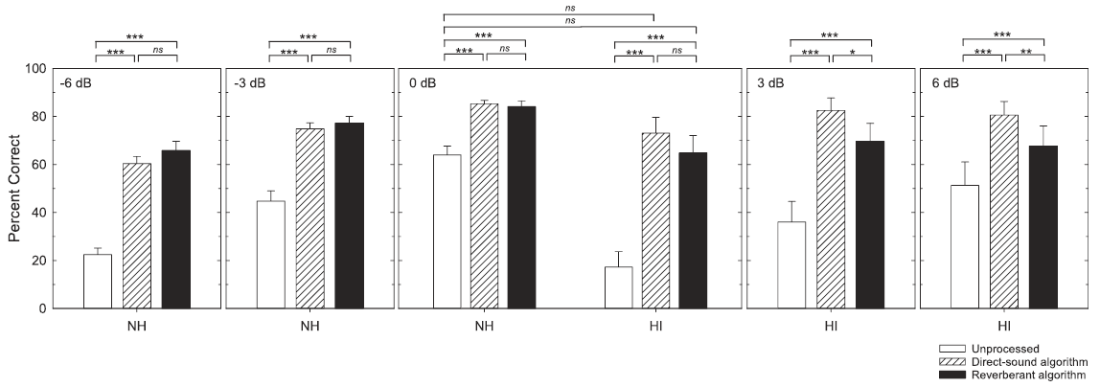
Listening test results and demos
First demonstration of intelligibility improvements for HI listeners in both interfering speech and room reverberation
At the common SNR of 0 dB, HI listeners with algorithm benefit outperform NH listeners without processing

Slide 20



Talker-independent speaker separation
This is the most general case, and it cannot be adequately addressed by training with many speaker pairs
This is due to the permutation problem (Hershey et al.’16), referring to the ambiguity of output-layer and speaker correspondence during training
1
1
?
Output 1
Features
Neural Network
2
3
?
Output 2

Slide 21
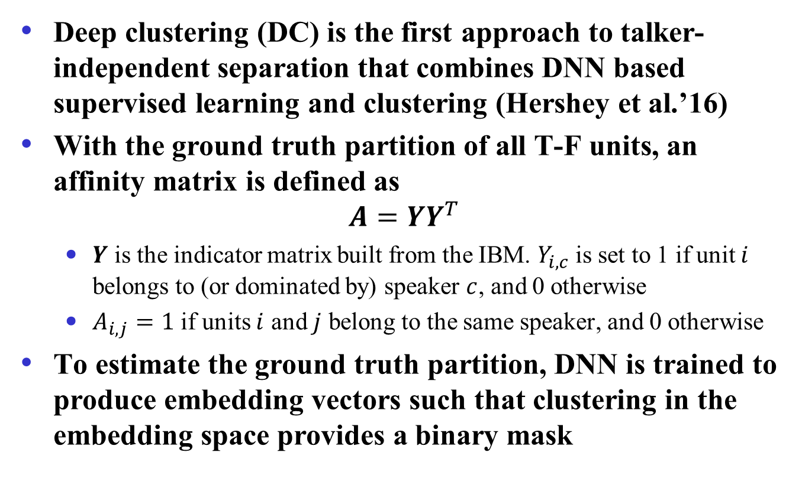
Deep clustering
Deep clustering (DC) is the first approach to talker-independent separation that combines DNN based supervised learning and clustering (Hershey et al.’16)
With the ground truth partition of all T-F units, an affinity matrix is defined as
$$A=YY^{T}$$
$Y$ is the indicator matrix built from the IBM. $Y_{i, c}$ is set to 1 if unit $i$ belongs to (or dominated by) speaker $c$, and 0 otherwise
$A_{i, j}=1$ if units $i$ and $j$ belong to the same speaker, and 0 otherwise
To estimate the ground truth partition, DNN is trained to produce embedding vectors such that clustering in the embedding space provides a binary mask

Slide 22
Permutation invariant training (PIT)
Recognizing that talker-dependent separation ties each DNN output to a specific speaker (permutation variant), PIT seeks to untie DNN outputs from speakers in order to achieve talker independence (Kolbak et al.’17)
Specifically, for a pair of speakers, there are two possible assignments, each of which is associated with a mean squared error (MSE). The assignment with the lower MSE is chosen and the DNN is trained to minimize the corresponding MSE
Frame-level PIT (tPIT): Permutation can vary from frame to frame, hence needs speaker tracing (sequential grouping) for speaker separation
Utterance-level PIT (uPIT): Permutation is fixed for a whole utterance, hence needs no speaker tracing

Slide 23
Deep CASA approach
Limitations of deep clustering and PIT
In deep clustering, embedding vectors for T-F units with similar energies from underlying speakers tend to be ambiguous
uPIT does not work as well as tPIT at the frame level, particularly for same-gender speakers, but tPIT requires speaker tracking
Speaker separation in CASA is talker-independent
CASA typically performs simultaneous grouping first, and then sequential grouping across time
With these observations, we proposed a deep CASA approach (Liu & Wang’19)
For simultaneous grouping, tPIT is employed to predict the spectra of underlying speakers at each frame
For sequential grouping, a sequence model is trained to assign simultaneously grouped spectra to underlying speakers

Slide 24
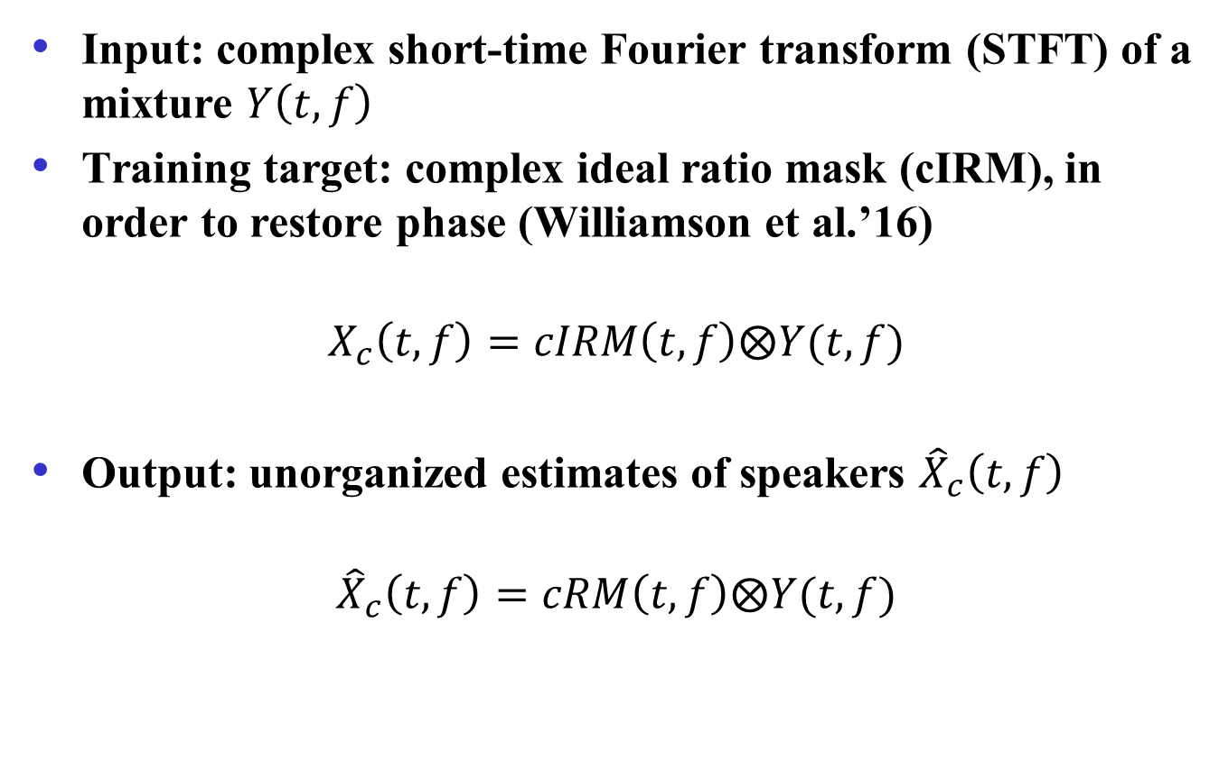
Simultaneous grouping
Input: complex short-time Fourier transform (STFT) of a mixture $Y\left(t,f\right)$
Training target: complex ideal ratio mask (cIRM), in order to restore phase (Williamson et al.’16)
$$X_{c}\left(t,f\right)=cIRM\left(t,f\right)⨂Y(t,f)$$
Output: unorganized estimates of speakers ${\hat{X}}_{c}\left(t,f\right)$
$${\hat{X}}_{c}\left(t,f\right)=cRM\left(t,f\right)⨂Y(t,f)$$

Slide 25
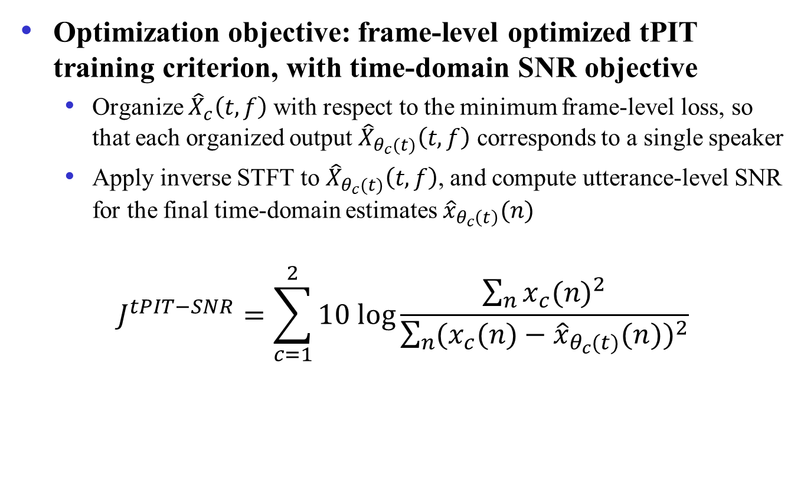
Simultaneous grouping (cont.)
Optimization objective: frame-level optimized tPIT training criterion, with time-domain SNR objective
Organize ${\hat{X}}_{c}\left(t,f\right)$with respect to the minimum frame-level loss, so that each organized output ${\hat{X}}_{θ_{c}(t)}\left(t,f\right)$ corresponds to a single speaker
Apply inverse STFT to ${\hat{X}}_{θ_{c}(t)}\left(t,f\right)$, and compute utterance-level SNR for the final time-domain estimates ${\hat{x}}_{θ_{c}\left(t\right)}(n)$
$$J^{tPIT−SNR}=\sum_{c=1}^{2}{10 log\frac{\sum_{n}{{x_{c}(n)}^{2}}}{\sum_{n}{{(x_{c}(n)−{\hat{x}}_{θ_{c}(t)}(n))}^{2}}}}$$

Slide 26
Simultaneous grouping network
A DenseUNet is proposed for simultaneous grouping
Downsampling (DS) layers, upsampling (US) layers and skip connections model global patterns and preserve fine-grained details
Densely connected convolutional layers exploit higher level of abstraction
Frequency mapping layers alleviate the inconsistency between different frequencies by reorganizing them in a new space

Slide 27
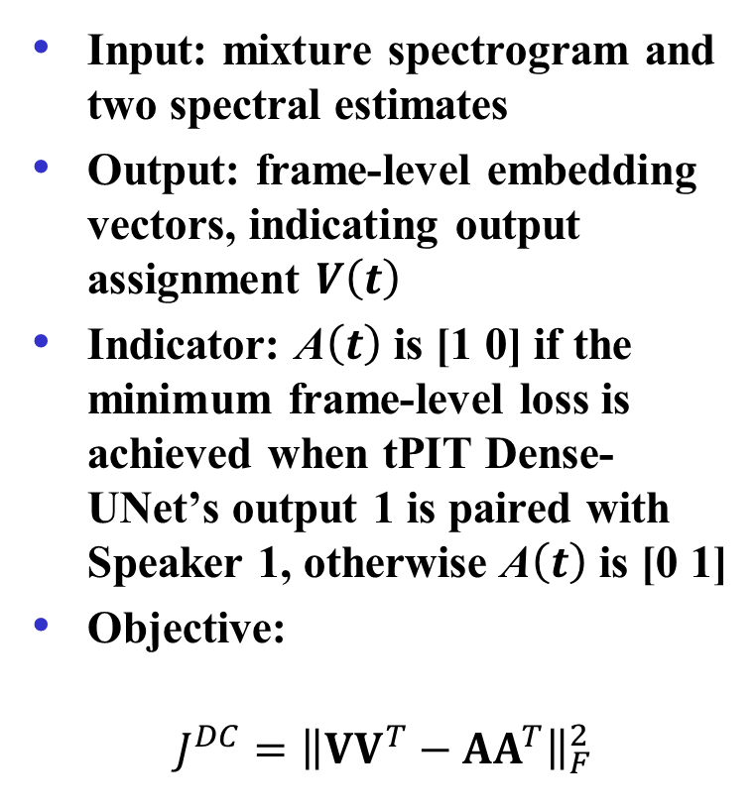
Sequential grouping
Input: mixture spectrogram and two spectral estimates
Output: frame-level embedding vectors, indicating output assignment $V\left(t\right)$
Indicator: A$\left(t\right)$ is [1 0] if the minimum frame-level loss is achieved when tPIT Dense-UNet’s output 1 is paired with Speaker 1, otherwise A$\left(t\right)$ is [0 1]
Objective:
$$J^{DC}={\left\|VV^{T}−AA^{T}\right\|}_{F}^{2}$$

Slide 28
Sequential grouping network
A temporal convolutional network (TCN) is employed as the sequence model
Preprocessed features are fed to 8 consecutive dilated convolutional blocks, with an exponentially increasing dilation factor
The 8 blocks are repeated 3 more times before embedding estimation

Slide 29
Evaluation
We use the WSJ0-2mix dataset, a monaural two-talker speaker separation dataset
A 30-hour training set and a 10-hour validation set
A 5-hour open-condition (OC) test set, with untrained speakers
Models
Deep CASA: tPIT Dense-UNet for simultaneous grouping and TCN for sequential grouping
uPIT Dense-UNet
Metrics: in addition to PESQ and extended STOI (ESTOI) we use
Signal-to-distortion ratio improvement (∆SDR)
Scale-invariant signal-to-noise ratio improvement (∆SI-SNR)

Slide 30
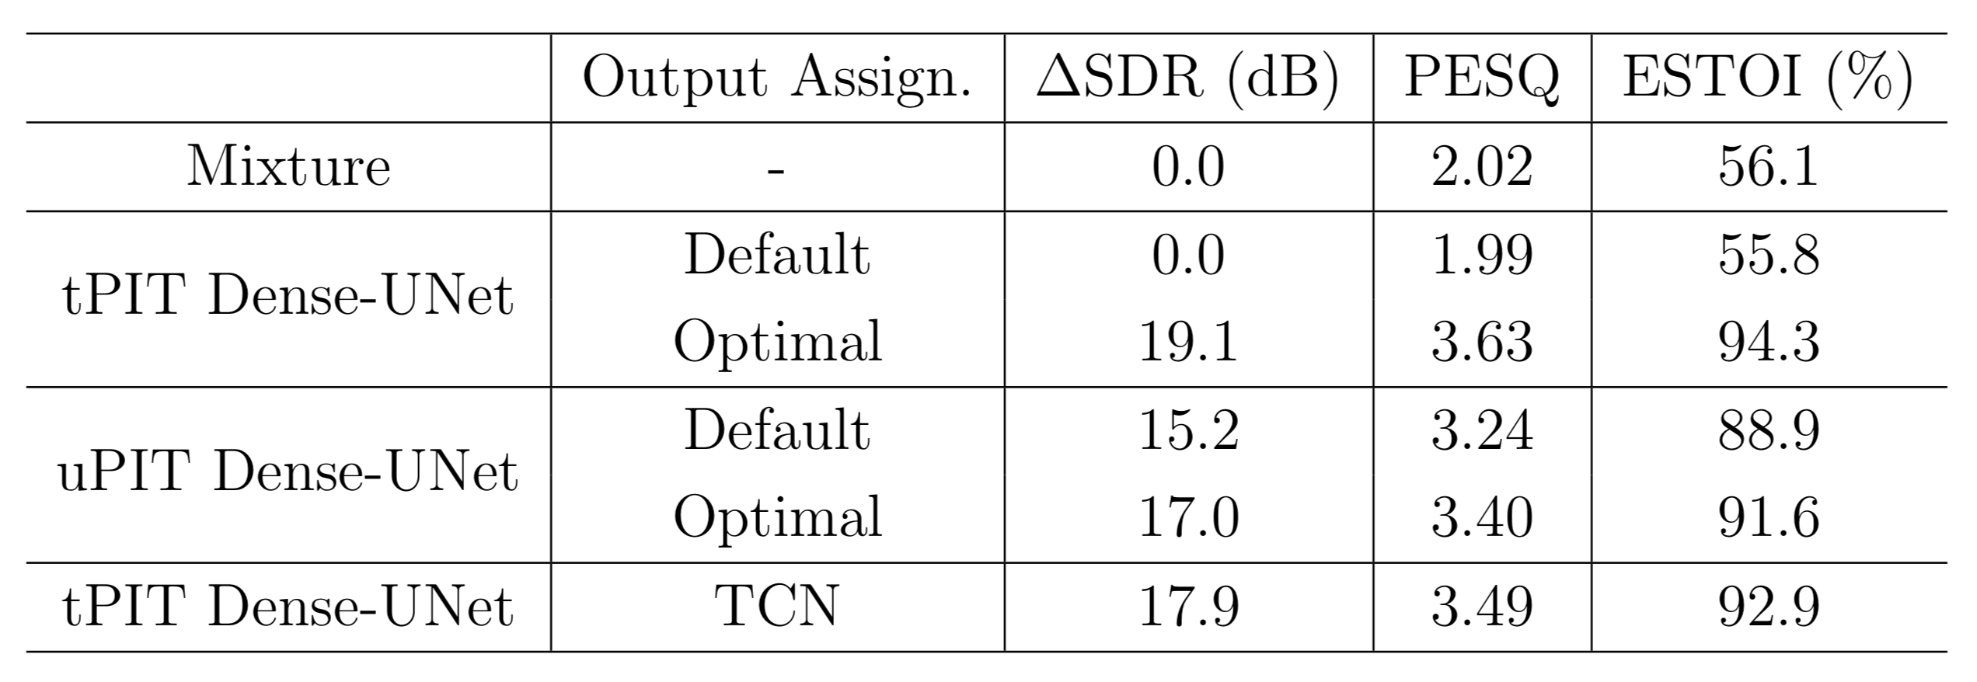
Results
Deep CASA
Notes:
PESQ range: 1.0~4.5
ESTOI: 0% ~ 100%

Slide 31
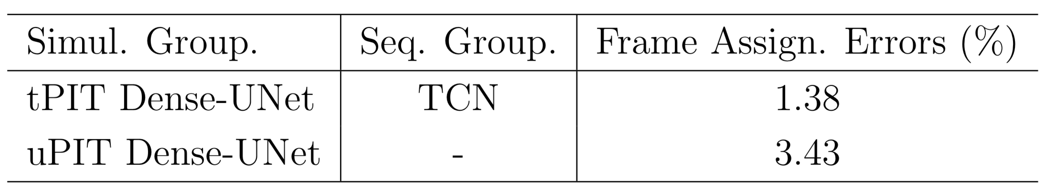
Sequential grouping comparison
Deep CASA
The results demonstrate the benefits of the proposed two-stage strategy, which optimizes frame-level separation and speaker tracking in turn, and achieves better performance in both objectives

Slide 32
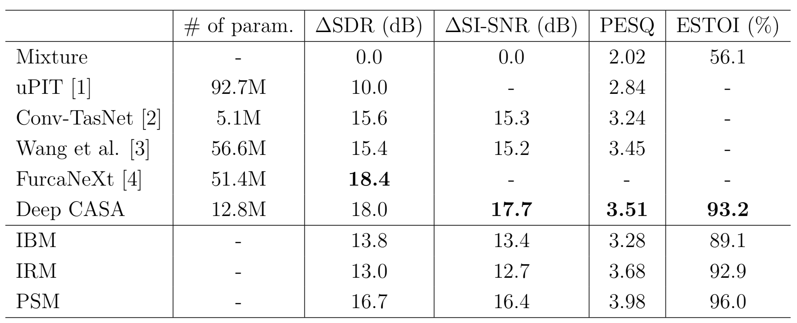
Speaker separation comparisons
Deep CASA produces very high quality speaker separation results, rivaling talker-dependent separation results
SDR improvements (in dB)
[1] Kolbak et al.’17; [2] Luo & Mesgarani’19; [3] Wang et al.’19; [4] Shi et al.’19

Slide 33

Two-speaker separation demos
New pair of speakers
Speaker1 - clean
Speaker2 - clean
Speaker1 -uPIT
Speaker2 - uPIT
Speaker1 – DC++
Speaker2 – DC++
Speaker1 – Deep CASA
Speaker2 – Deep CASA
Further demos | Mixture | Deep CASA | Clean
Noisy mixture (untrained)
Persian mixture (real recording) |  |  | /

Slide 34
IBM illustration
Deep CASA

Slide 35
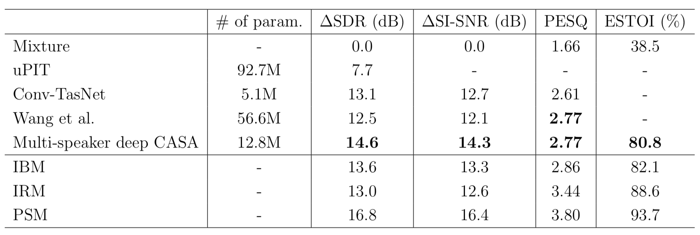
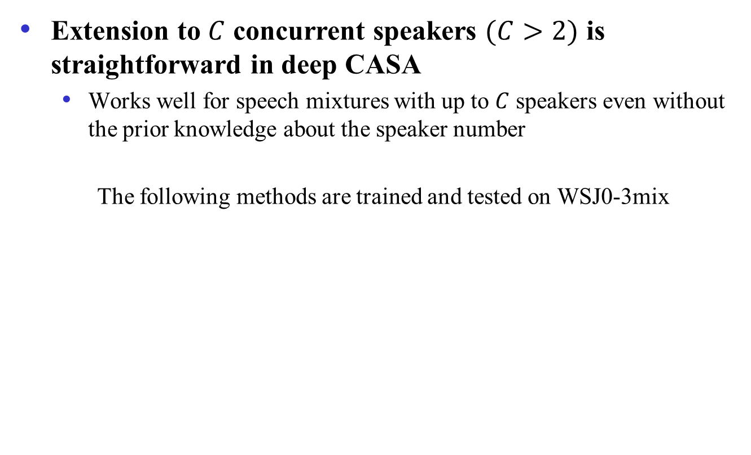
Multi-speaker case
Extension to $C$ concurrent speakers $(C>2)$ is straightforward in deep CASA
Works well for speech mixtures with up to $C$ speakers even without the prior knowledge about the speaker number
The following methods are trained and tested on WSJ0-3mix

Slide 36
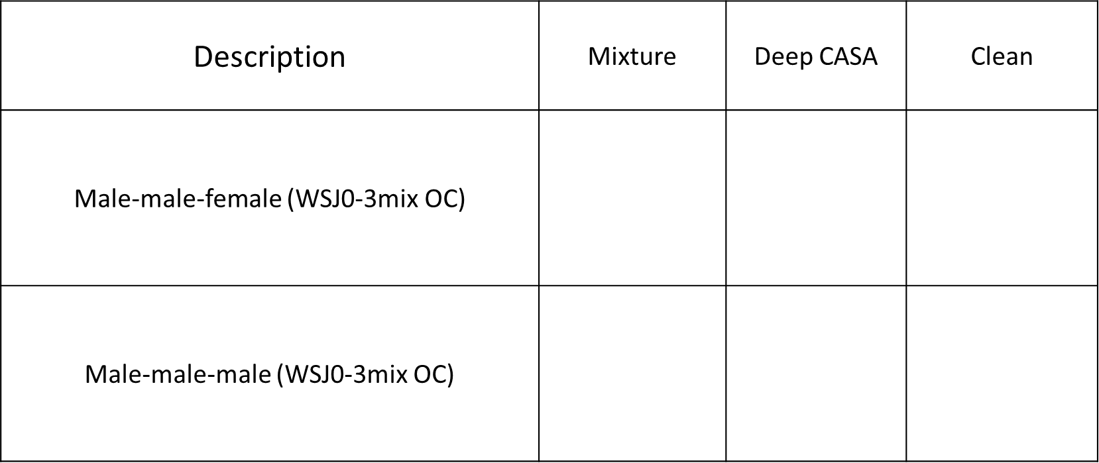
Three-speaker separation demos

Slide 37
A solution in sight for cocktail party problem?
What does a solution to the cocktail party problem look like?
A system that achieves human auditory analysis performance in all listening situations (Wang & Brown’06)
An automatic speech recognition (ASR) system that matches the human speech recognition performance in all noisy environments
Dependency on ASR

Slide 38

A solution in sight (cont.)?
A speech separation system that helps hearing-impaired listeners to achieve the same level of speech intelligibility as normal-hearing listeners in all noisy environments
This is my current working definition – see my IEEE Spectrum cover story in March, 2017

Slide 39
Conclusion
Formulation of the cocktail party problem as mask estimation enables the use of supervised learning
Supervised separation has yielded the first demonstrations of speech intelligibility improvement in noise and interfering speech in reverberation
A deep CASA framework for talker-independent speaker separation
Simultaneous and sequential grouping mechanisms have been realized in a deep learning model
State-of-the-art performance in separating multi-speaker mixtures
Source code will be released soon
The cocktail party problem is within reach

